Slide 1
Storage Class and Enum Datatypes

Slide 2
Storage Class:
It provide more information about variables and functions.
Four types of Storage calss in C:
Auto
Static
Extend
Register

Slide 6
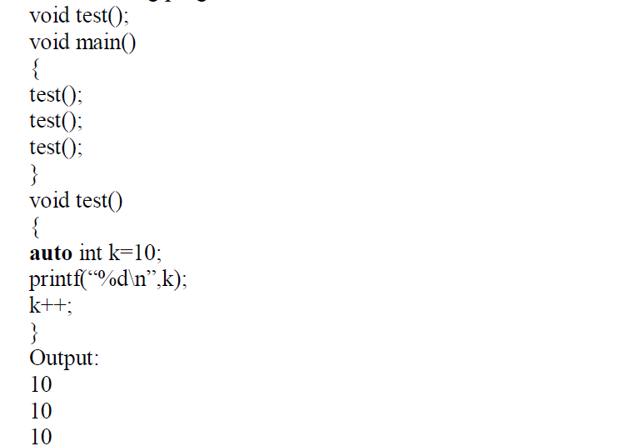

Slide 9
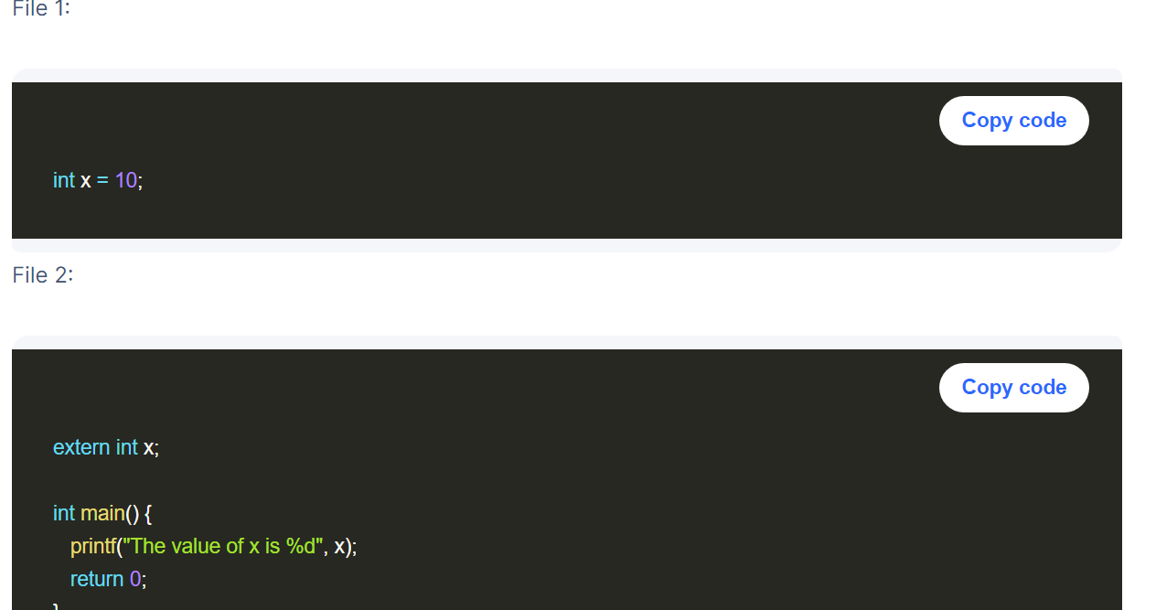

Slide 10
#include<stdio.h>
#include "other"
extern int a;
//auto int b;
void main()
{
// auto int a;// local value declaration is possible
// int c=10;// default all variable declaration are auto
//printf("%d",a);
//register int b;
//printf("\n %d",b);
printf("%d",a);
//printf("%d",c);
}
Other File
Int a=5

Slide 11
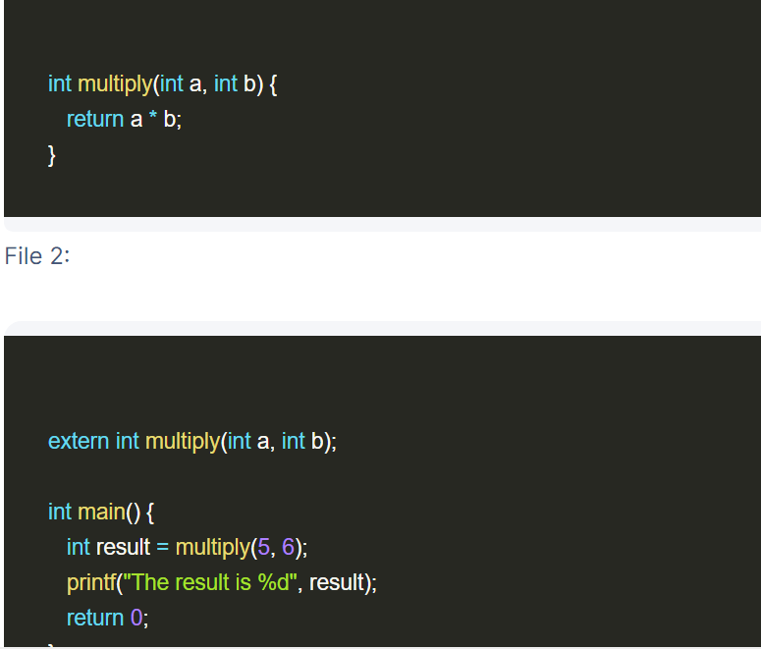

Slide 12
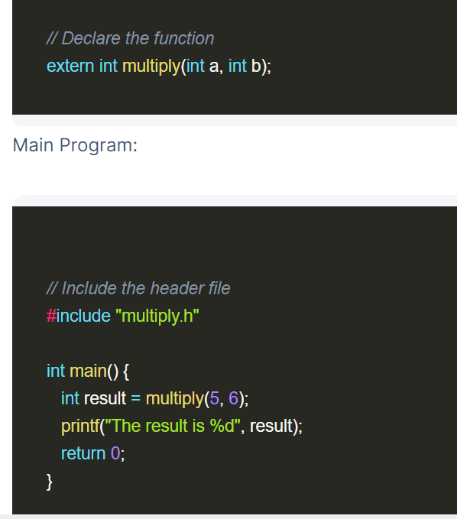

Slide 13
File two:
int multiply(int a, int b) {
return a * b;
}
#include<stdio.h>
#include "externfunction.h"
extern int multiply(int a, int b);
int main() {
int result = multiply(5, 6);
printf("The result is %d", result);
return 0;
}

Slide 14
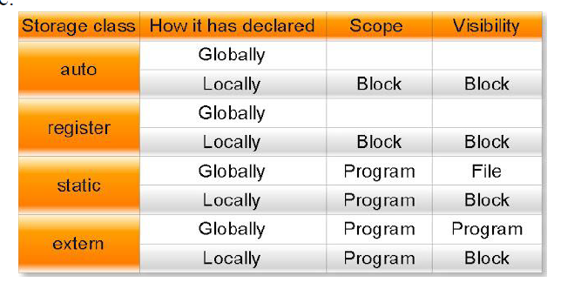
s

Slide 15
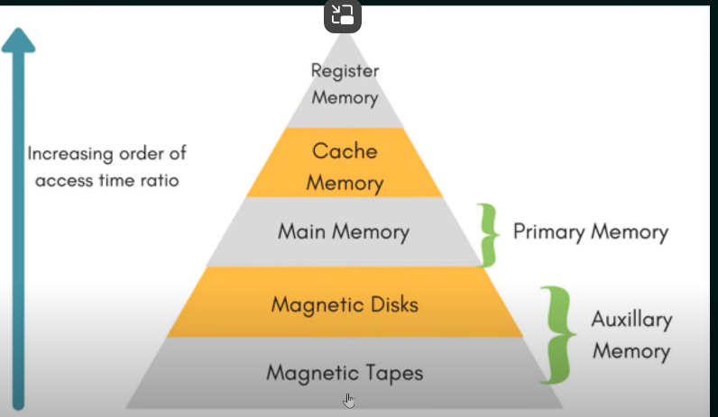

Slide 18
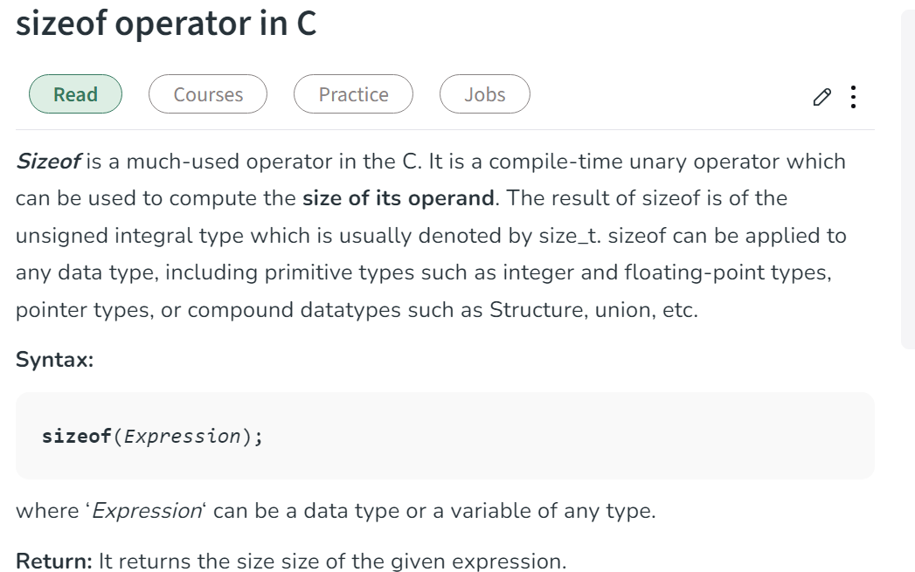

Slide 19
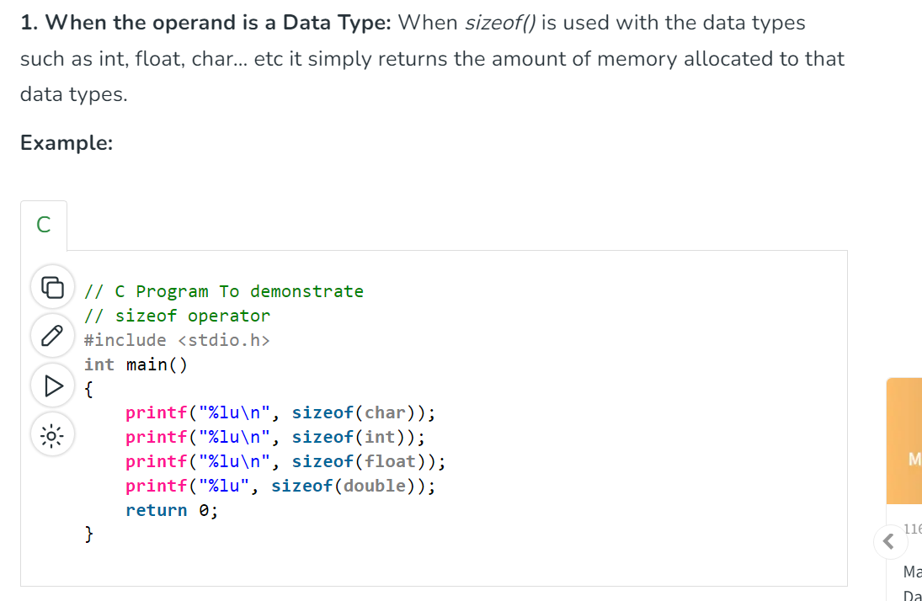
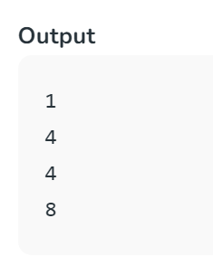

Slide 20
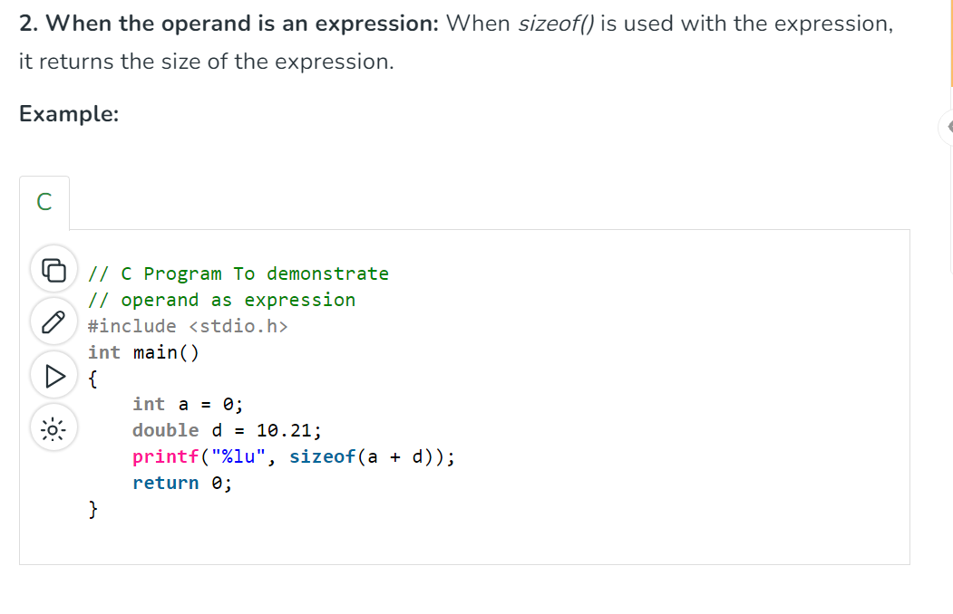

Slide 22
#include<stdio.h>
enum week{Mon, Tue, Wed, Thur, Fri, Sat, Sun};
int main()
{
enum week day;
day = Mon;
printf("%d",day);
return 0;
}
/*enum year{Jan, Feb, Mar, Apr, May, Jun, Jul,
Aug, Sep, Oct, Nov, Dec};
int main()
{
int i;
for (i=Jan; i<=Dec; i++)
printf("%d ", i);
return 0;
}*/

Slide 23
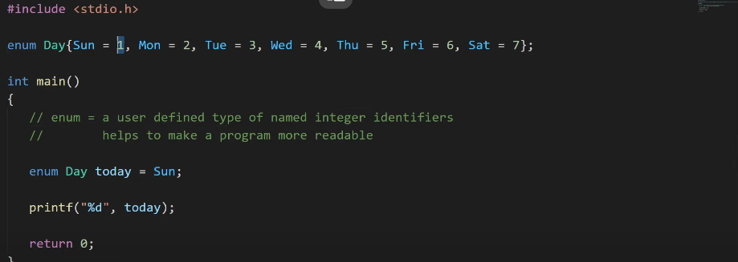

Slide 25
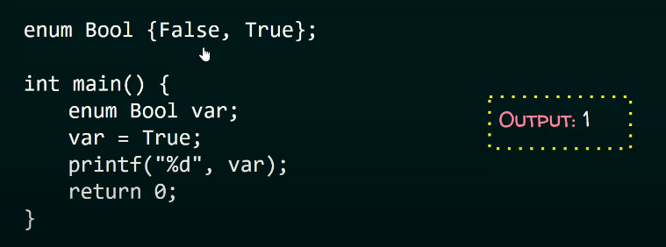

Slide 26
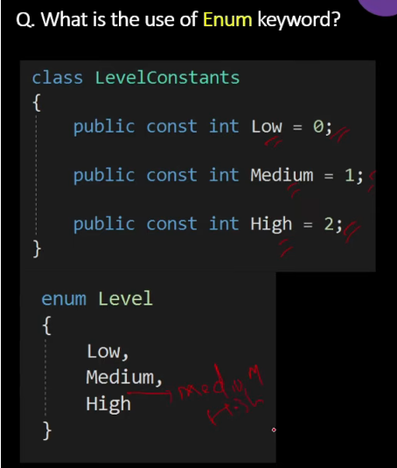

Slide 27
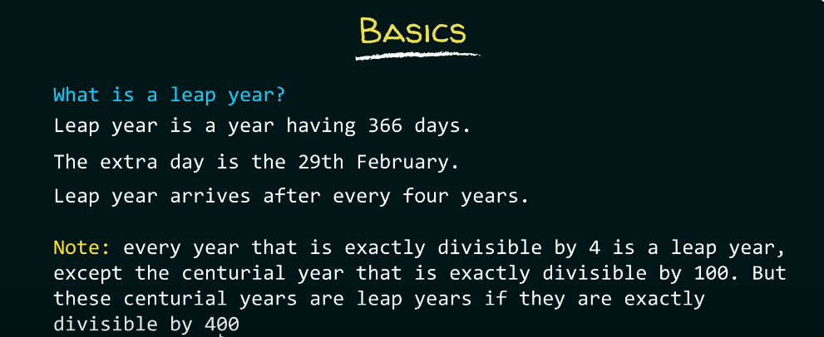

Slide 29
Thank You!!

